Slide 1

WES237B: Software for Embedded Systems
Pat Pannuto
Department of Computer Science and Engineering
University of California, San Diego
Summer Session 2022

Slide 2
Today
Morning
Performance & Optimization
Optimization in different levels (in the context of a single core)
Algorithmic (Cache Optimization), Compiler and Hardware
Memory Hierarchy
Afternoon
Lab session
Applying optimizations: Loop unrolling, hardware vectorization (NEON)
FIR Filters

Slide 3
Logistics
Assignment 2 due tomorrow
Assignment 3 released
Generally: First bit of assignment is lab portion, the rest is take-home
Finish the lab first if needed
Late policy?
1 week: 10% off
2 weeks: Last chance, 30% off
Email with any exceptional circumstances, we’ll work it out

Slide 4
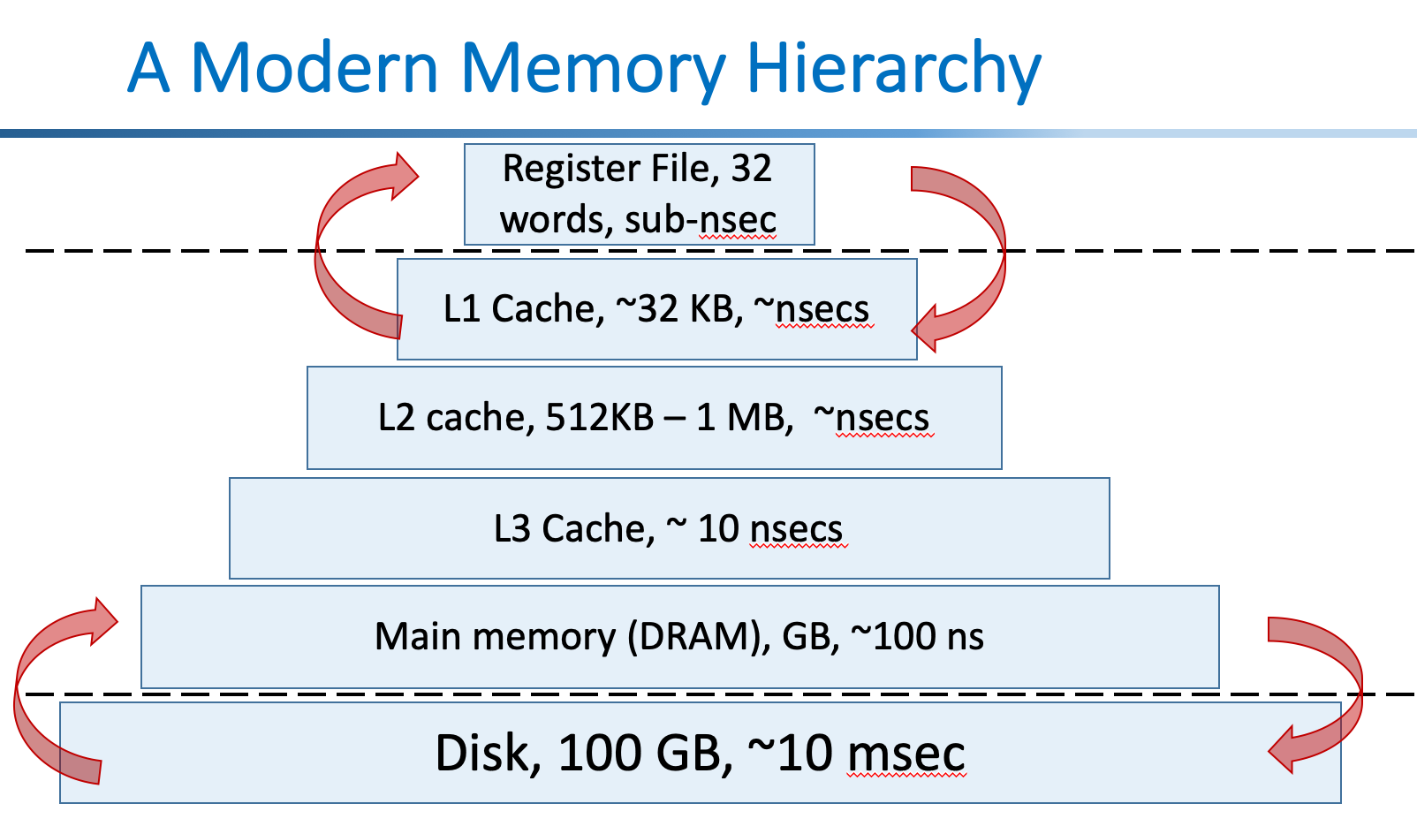
Recap
Measuring Performance
Speedup / performance always relative and workload specific
Amdahl’s Law: Optimization benefit limited to proportion it improves
Optimizations
Hard & Getting Harder due to heterogeneity
Must learn systems-level design and analysis
Microarchitecture
ILP, Superscalar, SIMD, and Pipelining
(perf: throughput)
Memory Hierarchy
Memory is slow, exploit spatial and temporal locality for performance

Slide 5
A Modern Memory Hierarchy
Register File, 32 words, sub-nsec
L1 Cache, ~32 KB, ~nsecs
L2 cache, 512KB – 1 MB, ~nsecs
L3 Cache, ~ 10 nsecs
Main memory (DRAM), GB, ~100 ns
Disk, 100 GB, ~10 msec

Slide 6
The guts of most interesting stuff is often ~this
void Foo(float* const A, float* const B, float* const C, const int M, const int N, const int K)
{
for (int m = 0; m < M; m++) {
for (int n = 0; n < N; n++) {
for (int k = 0; k < K; k++) {
C[m * M + n] += A[m * M + k] * B[k * K + n];
}
}
}
}
Lab2: image.tif
480x640 pixels * 4 bytes/float ~= 1.3 MB (greyscale!)
And these are huge
Notes:
Not literally these loops, but multi-dimensional math, which boils down to loops of basic op’s marching through arrays

Slide 7
Cache

Slide 8
Cache
Cache: A smaller, faster storage device that acts as a staging area for a subset of the data in a larger, slower device.
Fundamental idea of a memory hierarchy:
For each k, the faster, smaller device at level k serves as a cache for the larger, slower device at level k+1.
Why do memory hierarchies work?
Because of locality, programs tend to access the data at level k more often than they access the data at level k+1.
Thus, the storage at level k+1 can be slower, and thus larger and cheaper per bit.
Big Idea: The memory hierarchy creates a large pool of storage that costs as much as the cheap storage near the bottom, but that serves data to programs at the rate of the fast storage near the top.
Bryant and O’Hallaron, Computer Systems: A Programmer’s Perspective; Third Edition

Slide 9
Cache hierarchy vocabulary
Cache hit: When data needed by CPU is in the cache
Cache miss: When data needed by CPU is not in the cache
Cache controller must fetch data into cache and return it to CPU
Compulsory miss, conflict miss, capacity miss
THRASHING
Cache tag
Cache valid
Evict
Cache block or Cache Line

Slide 10
Locality and cacheing
Memory hierarchies exploit locality by cacheing (keeping close to the processor) data likely to be used again.
This is done because we can build large, slow memories and small, fast memories, but we can’t build large, fast memories.
If it works, we get the illusion of SRAM access time with disk capacity
SRAM access times are ~1ns at cost of $2000 to $5000 per Gbyte.
DRAM access times are ~70ns at cost of $20 to $75 per Gbyte.
Disk access times are 5 to 20 million ns at cost of $.20 to $2 per Gbyte.
Notes:
DMT: I can’t remember if I checked this data recently. May be obsolete.

Slide 11
A typical memory hierarchy
small
CPU
expensive $/bit
memory
fast
memory
on-chip caches
memory
off-chip cache
memory
main memory
big
memory
cheap $/bit
disk
slow
so then where is my program and data??
Notes:
DMT: I keep this structure, even though off-chip caches are less common. But they are a possibility, and not non-existent. But I do mention they are rare now (used to be required)

Slide 12
Cache Fundamentals
cpu
lowest-level
cache
next-level
memory/cache
Notes:
DMT: I do spend a fair amount of time on next few slides.

Slide 13
Cache Fundamentals
cpu
lowest-level
cache
cache hit -- an access where the data is found in the cache.
next-level
memory/cache

Slide 14
Cache Fundamentals
cpu
lowest-level
cache
cache hit -- an access where the data is found in the cache.
cache miss -- an access which isn’t
next-level
memory/cache

Slide 15
Cache Fundamentals
cpu
lowest-level
cache
cache hit -- an access where the data is found in the cache.
cache miss -- an access which isn’t
hit time -- time to access the cache
next-level
memory/cache

Slide 16
Cache Fundamentals
cpu
lowest-level
cache
cache hit -- an access where the data is found in the cache.
cache miss -- an access which isn’t
hit time -- time to access the cache
miss penalty -- time to move data from further level to closer
next-level
memory/cache

Slide 17
Cache Fundamentals
cpu
lowest-level
cache
cache hit -- an access where the data is found in the cache.
cache miss -- an access which isn’t
hit time -- time to access the cache
miss penalty -- time to move data from further level to closer
hit ratio -- percentage of time the data is found in the cache
next-level
memory/cache

Slide 18
Cache Fundamentals
cpu
lowest-level
cache
cache hit -- an access where the data is found in the cache.
cache miss -- an access which isn’t
hit time -- time to access the cache
miss penalty -- time to move data from further level to closer
hit ratio -- percentage of time the data is found in the cache
miss ratio -- (1 - hit ratio)
next-level
memory/cache
Notes:
I usually try and get them to figure out why architects prefer miss ratio (scales with performance better than hit ratio)

Slide 19
Cache Fundamentals, cont.
cache block size or cache line size– the amount of data that gets transferred on a cache miss.
cpu
lowest-level
cache
next-level
memory/cache
Notes:
DMT: architects are really bad about having multiple names for things. It’s tempting to simplify and consistently stick to a single term, but then they go out and hear the other and don’t know what it means.

Slide 20
Cache Fundamentals, cont.
cache block size or cache line size – the amount of data that gets transferred on a cache miss.
instruction cache – cache that only holds instructions.
cpu
lowest-level
cache
next-level
memory/cache

Slide 21
Cache Fundamentals, cont.
cache block size or cache line size – the amount of data that gets transferred on a cache miss.
instruction cache – cache that only holds instructions.
data cache – cache that only caches data.
cpu
lowest-level
cache
next-level
memory/cache

Slide 22
Cache Fundamentals, cont.
cache block size or cache line size – the amount of data that gets transferred on a cache miss.
instruction cache – cache that only holds instructions.
data cache – cache that only caches data.
unified cache – cache that holds both.
cpu
lowest-level
cache
next-level
memory/cache

Slide 23
Cacheing Issues
cpu
access
On a memory access -
How do I know if this is a hit or miss?
On a cache miss -
where to put the new data?
what data to throw out?
how to remember what data this is?
lowest-level
cache
miss
next-level
memory/cache

Slide 24
Hardware implications on cache design
Caches are basically the thing that make real workloads fast
The size of a cache is inversely proportional to its speed
Smaller caches are faster
And every bit counts
This is why caches use as few bits as possible to do their work
This makes caches tricky to walk through as a human

Slide 25
A simple cache
address string:
4 00000100
8 00001000
12 00001100
4 00000100
8 00001000
20 00010100
4 00000100
8 00001000
20 00010100
24 00011000
12 00001100
8 00001000
4 00000100
the tag identifies
the address of
the cached data
tag
data
4 entries, each block holds one word, any block
can hold any word.
A cache that can put a line of data anywhere is called __________________________
The most popular replacement strategy is LRU ( ).
Notes:
DMT: I walk through these examples slowly. For each address, finding the index bits and tag bits and recording hit or miss, and updating the cache picture.
“fully associative”
“least recently used”
(I know these answers are elementary for you, but you’ll be amazed what you can forget when you’re in front of a crowd, so it’s good to keep notes on even the most basic things)

Slide 26
A simple cache
address string:
4 00000100
8 00001000
12 00001100
4 00000100
8 00001000
20 00010100
4 00000100
8 00001000
20 00010100
24 00011000
12 00001100
8 00001000
4 00000100
the tag identifies
the address of
the cached data
tag
data
4 entries, each block holds one word, any block
can hold any word.
A cache that can put a line of data anywhere is called Fully Associative
The most popular replacement strategy is LRU ( Least Recently Used ).
Notes:
DMT: I walk through these examples slowly. For each address, finding the index bits and tag bits and recording hit or miss, and updating the cache picture.
“fully associative”
“least recently used”
(I know these answers are elementary for you, but you’ll be amazed what you can forget when you’re in front of a crowd, so it’s good to keep notes on even the most basic things)

Slide 27
A simpler cache
address string:
4 00000100
8 00001000
12 00001100
4 00000100
8 00001000
20 00010100
4 00000100
8 00001000
20 00010100
24 00011000
12 00001100
8 00001000
4 00000100
an index is used
to determine
which line an address
might be found in
tag
data
00000100
4 entries, each block holds one word, each word
in memory maps to exactly one cache location.
A cache that can put a line of data in exactly one place is called __________________.
Advantages/disadvantages vs. fully-associative?
Notes:
“direct mapped”

Slide 28
A simpler cache
address string:
4 00000100
8 00001000
12 00001100
4 00000100
8 00001000
20 00010100
4 00000100
8 00001000
20 00010100
24 00011000
12 00001100
8 00001000
4 00000100
an index is used
to determine
which line an address
might be found in
tag
data
00000100
4 entries, each block holds one word, each word
in memory maps to exactly one cache location.
A cache that can put a line of data in exactly one place is called direct mapped
Advantages/disadvantages vs. fully-associative?
Notes:
“direct mapped”

Slide 29
A set-associative cache
address string:
4 00000100
8 00001000
12 00001100
4 00000100
8 00001000
20 00010100
4 00000100
8 00001000
20 00010100
24 00011000
12 00001100
8 00001000
4 00000100
00000100
tag
data
tag
data
4 entries, each block holds one word, each word
in memory maps to one of a set of n cache lines
A cache that can put a line of data in exactly n places is called n-way ______________________.
The cache lines/blocks that share the same index are a cache ____________.
Notes:
DMT: they’re starting to get the idea, but pretty important to illustrate associativity.
“set”

Slide 30
A set-associative cache
address string:
4 00000100
8 00001000
12 00001100
4 00000100
8 00001000
20 00010100
4 00000100
8 00001000
20 00010100
24 00011000
12 00001100
8 00001000
4 00000100
00000100
tag
data
tag
data
4 entries, each block holds one word, each word
in memory maps to one of a set of n cache lines
A cache that can put a line of data in exactly n places is called n-way set-associative.
The cache lines/blocks that share the same index are a cache set.
Notes:
DMT: they’re starting to get the idea, but pretty important to illustrate associativity.
“set”

Slide 31
Longer Cache Blocks
address string:
4 00000100
8 00001000
12 00001100
4 00000100
8 00001000
20 00010100
4 00000100
8 00001000
20 00010100
24 00011000
12 00001100
8 00001000
4 00000100
00000100
tag
data
4 entries, each block holds two words, each word
in memory maps to exactly one cache location
(this cache is twice the total size of the prior caches).
Large cache blocks take advantage of spatial locality.
Too large of a block size can waste cache space.
Longer cache blocks require less tag space
Notes:
DMT: by this one, we may be stretching their patience. So I do want to get the big concept across (ie, showing how you can get a hit on first access to a word), but may otherwise go through this one a little more quickly.

Slide 32
Longer Cache Blocks
address string:
4 00000100
8 00001000
12 00001100
4 00000100
8 00001000
20 00010100
4 00000100
8 00001000
20 00010100
24 00011000
12 00001100
8 00001000
4 00000100
00000100
tag
data (now 64 bits)
4 entries, each block holds two words, each word
in memory maps to exactly one cache location
(this cache is twice the total size of the prior caches).
Large cache blocks take advantage of spatial locality.
Too large of a block size can waste cache space.
Longer cache blocks require less tag space
Notes:
DMT: by this one, we may be stretching their patience. So I do want to get the big concept across (ie, showing how you can get a hit on first access to a word), but may otherwise go through this one a little more quickly.

Slide 33
Q: Describing Cache Type Tradeoffs?
Exceptional usage of the cache space in exchange for a slow hit time
Poor usage of the cache space in exchange for an excellent hit time
Reasonable usage of cache space in exchange for a reasonable hit time
Selection | Fully-Associative | 4-way Set Associative | Direct Mapped
A | 3 | 2 | 1
B | 3 | 3 | 2
C | 1 | 2 | 3
D | 3 | 2 | 1
E | None of the above
Notes:
Correct Answer - C

Slide 34
Back to Block Size
If block size increases spatial locality, should we just make the cache block size really, really big????

Slide 35
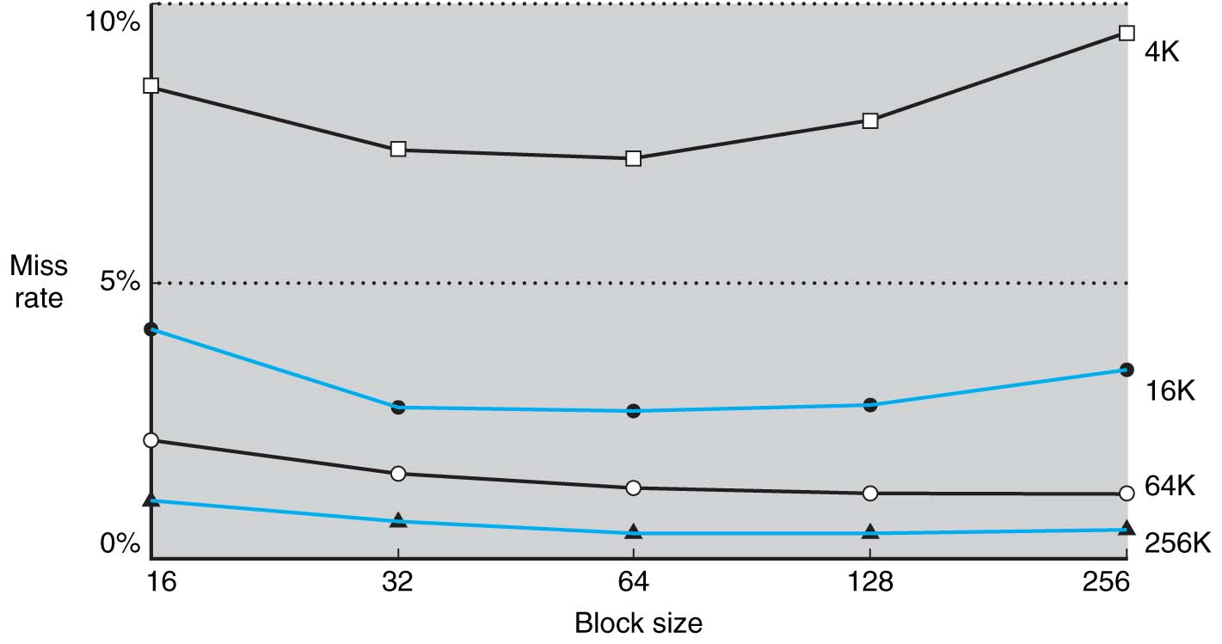
Block Size and Miss Rate

Slide 36
Cache Parameters
Cache size = Number of sets * block size * associativity
tag
data
tag
data
Bytes per block
Sets per Cache
Blocks per set
Warning / Notice—Things that count towards “cache size”: cache data
Things that do not count towards “cache size”: tags, valid bits, etc…
Notes:
DMT: I really try and push the idea that caches are three dimensional entities, and best understood that way, and size is just the product of the three.
Oh, and by the way, it is not obvious to them that “cache size” only counts the data array (not tags, metadata, etc.), so need to emphasize that.

Slide 37
Cache Parameters
Cache size = Number of sets * block size * associativity
tag
data
tag
data
Is this very confusing?
Yes, until you implement one.
It is what the world has settled on, so you need to know this and become comfortable with it.
Bytes per block
Sets per Cache
Blocks per set
Warning / Notice—Things that count towards “cache size”: cache data
Things that do not count towards “cache size”: tags, valid bits, etc…
Notes:
DMT: I really try and push the idea that caches are three dimensional entities, and best understood that way, and size is just the product of the three.
Oh, and by the way, it is not obvious to them that “cache size” only counts the data array (not tags, metadata, etc.), so need to emphasize that.

Slide 38
Cache Parameters
Cache size = Number of sets * block size * associativity
128 blocks, 32-byte block size, direct mapped, size = ?
128 KB cache, 64-byte blocks, 512 sets, associativity = ?
(always keep in mind “cache size” only counts the data storage)

Slide 39
Q: How many bits for each field?
N-bit address
tag index block offset
Generally, we have variables block_size, cache_size, and memory_size
Let’s work it out for
BS = 8 bytes
CS = 1 KB
MS = 4 MB
And we have a 4-way set-associative cache?
What is the…
Number of bits for the block offset: ____
Number of bits for the index: ____
Number of bits for the tag: ____
Notes:
Correct Answer - C
DMT: In the past, I usually haven’t given them the formulas. I prefer to just reason about them. “need to choose between 256 sets, so must be log 256, or 8 bits”. This kind of hits the middle ground. They get the formulas here, but don’t show up in their permanent notes (since clicker questions don’t go in the slides I post).

Slide 40
Q: How many bits for each field?
N-bit address
tag index block offset
Generally, we have variables block_size, cache_size, and memory_size
Let’s work it out for
BS = 32 bytes
CS = 16 KB
MS = 8 MB
And we have a 8-way set-associative cache?
What is the…
Number of bits for the block offset: ____
Number of bits for the index: ____
Number of bits for the tag: ____
Notes:
Correct Answer - C
DMT: In the past, I usually haven’t given them the formulas. I prefer to just reason about them. “need to choose between 256 sets, so must be log 256, or 8 bits”. This kind of hits the middle ground. They get the formulas here, but don’t show up in their permanent notes (since clicker questions don’t go in the slides I post).

Slide 41
Handling a Cache Access
1. Use index and tag to access cache and determine hit/miss.
2. If hit, return requested data.
3. If miss, select a cache block to be replaced, and access memory or next lower cache (possibly stalling the processor).
load entire missed cache line into cache
return requested data to CPU (or higher cache)
4. If next lower memory is a cache, goto step 1 for that cache.

Slide 42
Accessing a Sample Cache
64 KB cache, direct-mapped, 32-byte cache block size
31 30 29 28 27 .......... 17 16 | 15 14 13 12 11 10 9 8 7 6 5 | 4 3 2 1 0
tag
index
11
block offset
16
valid
tag
data
0
1
2
...
...
...
...
2045
2046
2047
64 KB / 32 bytes =
2 K cache blocks/sets
256
=
hit/miss
32

Slide 43
Accessing a Sample Cache
32 KB cache, 2-way set-associative, 16-byte block size
31 30 29 28 27 .......... 17 16 15 14 | 13 12 11 10 9 8 7 6 5 4 | 3 2 1 0
tag
index
10
block offset
18
valid
tag
data
valid
tag
data
0
1
2
...
...
...
...
1021
1022
1023
32 KB / 16 bytes / 2 =
1 K cache sets
=
=
hit/miss

Slide 44
Cache Alignment
memory address
tag index block offset
The data that gets moved into the cache on a miss are all data whose addresses share the same tag and index (regardless of which data gets accessed first).
This results in
no overlap of cache lines
easy mapping of addresses to cache lines (no additions)
data at address X always being present in the same location in the cache block (at byte X mod blocksize) if it is there at all.
Think of main memory as organized into cache-line sized pieces (because in reality, it is!).
Memory
0
1
2
3
4
5
6
7
8
9
10
.
.
.
.
.
.
Notes:
DMT: another thing not nearly as obvious to them as it is to us.

Slide 45
How does the cache actually connect to the execution core?
This is a “standard, five stage pipeline”
For machines with no caches, the “DM” looks more like this:
IM
Reg
ALU
DM
Reg
ALU
DM
Address
Memory Interface Module
Data
Data
Read?
Write?

Slide 46
How does the cache actually connect to the execution core?
This is a “standard, five stage pipeline”
For machines with no caches, the “DM” looks more like this:
IM
Reg
ALU
DM
Reg
ALU
DM
Address
Memory Interface Module
Data
Data
Stall
Read?
Other
Peripherals
Write?
Memory Bus
DRAM Controller
DRAM

Slide 47
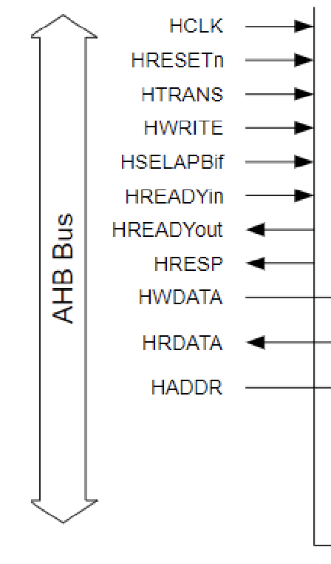
How does the cache actually connect to the execution core? [ Simplified View! Very different between embedded & high-perf! ]
ALU
DM
Address
Memory Interface Module
Data
Data
Stall
Read?
Other
Peripherals
Write?
Memory Bus
DRAM Controller
DRAM

Slide 48
How does the cache actually connect to the execution core? [ Simplified View! Very different between embedded & high-perf! ]
ALU
DM
Address
Memory Interface Module
Data
Data
Stall
Read?
Other
Peripherals
Write?
Memory Bus
Cache(s)
DRAM Controller
DRAM

Slide 49
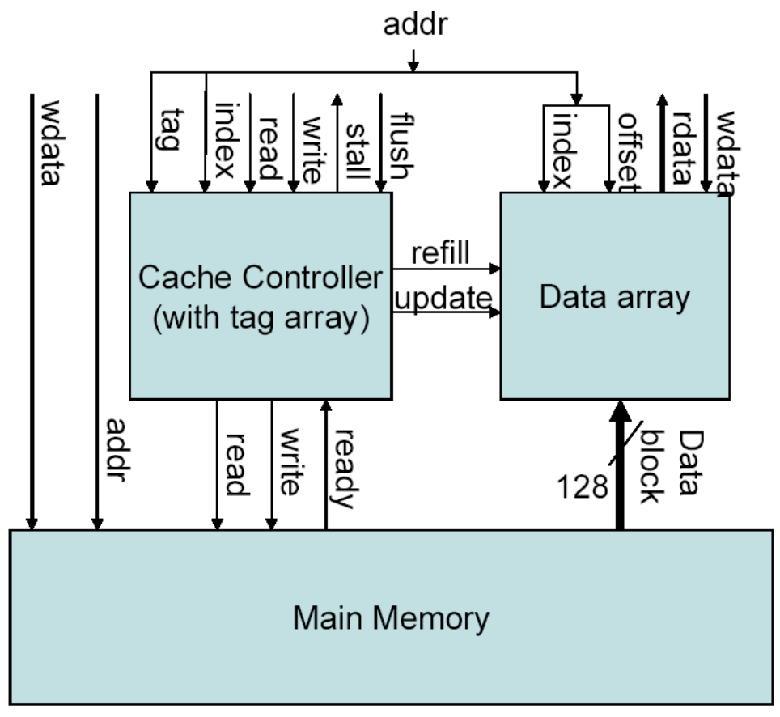
How does the cache actually connect to the execution core? [ Simplified View! Very different between embedded & high-perf! ]
ALU
DM
Address
Memory Interface Module
Data
Data
Stall
Read?
Other
Peripherals
Write?
L1 Cache
Memory Bus
DRAM Controller
DRAM
A real interface (from a simple design)

Slide 50
Cache Alignment Revisited
memory address
tag index block offset
The data that gets moved into the cache on a miss are all data whose addresses share the same tag and index (regardless of which data gets accessed first).
Think of main memory as organized into cache-line sized pieces (because in reality, it is!).
“Block-aligned” access is similar to the “word-aligned” access you have been thinking about already
Core <> Cache interface: Word aligned
Cache <> Mem interface: Block aligned
Memory
0
1
2
3
4
5
6
7
8
9
10
.
.
.
.
.
.
Notes:
DMT: another thing not nearly as obvious to them as it is to us.

Slide 51
When executing code, what does all this have to do with performance and alignment?
IM
Reg
ALU
DM
Reg
Notes:
Draw out the simplified view, DM <> Cache to make the hit time point, Cache <> Memory to make the alignment point

Slide 52
Which of the following things are possible?
It is possible to make a “set-associative” cache to hav N=1 sets?
It is possible for a set-associative cache to have N=3 sets?
It is possible for a cache to have a 12-byte block size?
Selection | Fully-Associative | 4-way Set Associative | Direct Mapped
A | 3 | 2 | 1
B | 3 | 3 | 2
C | 1 | 2 | 3
D | 3 | 2 | 1
E | None of the above
Notes:
Correct Answer - C

Slide 53
Associative Caches
Higher hit rates, but...
longer access time
(longer to determine hit/miss, more muxing of outputs)
more space (longer tags)
16 KB, 16-byte blocks, DM, tag = ?
16 KB, 16-byte blocks, 4-way, tag = ?
Notes:
DMT: really savvy ones can be a bit skeptical here, knowing that simple muxes aren’t that big a deal. This is where I usually explain (going back to a previous picture) that the biggest difference is between DM and 2-way because with DM you can read the data immediately without waiting for the tag check. For n-way, you need to wait. Then the incremental cost 2-way, 3-way, 8-way, etc. is much smaller after that.

Slide 54
for (int i = 0; i < 10,000,000; i++)
sum += A[i];
Assume each element of A is 4 bytes and sum is kept in a register. Assume a baseline direct-mapped 32KB L1 cache with 32 byte blocks. Assume this loop is visited many times.
Which changes would help the hit rate of the above code?
Selection | Change
A | Increase to 2-way set associativity
B | Increase block size to 64 bytes
C | Increase cache size to 64 KB
D | A and C combined
E | A, B, and C combined
Notes:
Correct Answer – B – HW flipped heads (stays the same)
Primary Purpose: Having students understand the impact of block size, cache size, and associativity
Concept: Aid students in understanding the interaction of caches and real code.
Expected mistakes: Not realizing set-associativity (A) and cache size (C) are irrelevant for streaming behavior
Post Discussion: Discuss how each improvement would change the cache behavior

Slide 55
for (int i=0; i < 10,000,000; i++)
for (int j = 0; j < 8192; j++)
sum += A[j] – B[j];
Assume each element of A and B are 4 bytes.
Assume each array is at least 32KB in size.
Assume sum is kept in a register.
Assume a baseline direct-mapped 32KB L1 cache with 32 byte blocks.
Which changes would help the hit rate of the above code?
Selection | Change
A | Increase to 2-way set associativity
B | Increase block size to 64 bytes
C | Increase cache size to 64 KB
D | A and C combined
E | A, B, and C combined
Notes:
Correct Answer - E
Expected mistakes: Not realizing (B) still helps for the first iteration if combined with A and C. Also – (A) is subtle. Because A and B are at least 32KB in size and the cache is 32KB – conflict misses are guaranteed. Depending on how the addresses are laid out, the two arrays MAY not conflict with a 64KB cache, but it is more likely that they would. 2-way associativity would guarantee they could each stay in the cache without conflicts.

Slide 56
Dealing with Stores
Stores must be handled differently than loads, because...
they don’t necessarily require the CPU to stall.
they change the content of cache/memory (creating memory consistency issues)
Q: Can you think of a situation when you might need to load from memory before you can execute a store?
Can you think of another one?
Notes:
“read”
Two situations:
- Store byte/halfword on a word-architected machine
- Cache block > word

Slide 57
Policy decisions for stores
Keep memory and cache identical?
_____________________ => all writes go to both cache and main memory
_____________________ => writes go only to cache. Modified cache lines are written back to memory when the line is replaced.
Make room in cache for store miss?
write-allocate => on a store miss, bring written line into the cache
write-around => on a store miss, ignore cache
Notes:
“write-through”
“write-back”

Slide 58
Dealing with stores
On a store hit, write the new data to cache.
In a write-through cache, write the data immediately to memory.
In a write-back cache, mark the line as dirty.
On a store miss, initiate a cache block load from memory for a write-allocate cache.
Write directly to memory for a write-around cache.
On any kind of cache miss in a write-back cache, if the line to be replaced in the cache is dirty, write it back to memory.

Slide 59
Cache Performance
CPI = BCPI + MCPI
BCPI = base CPI, which means the CPI assuming perfect memory
MCPI = the memory CPI, the number of cycles (per instruction) the processor is stalled waiting for memory.
MCPI = accesses/instruction * miss rate * miss penalty
this assumes we stall the pipeline on both read and write misses, that the miss penalty is the same for both, that cache hits require no stalls.
If the miss penalty or miss rate is different for Inst cache and data cache (common case), then
MCPI = I$ accesses/inst x I$MissRate x I$MissPenalty
+ D$ accesses/inst x D$MissRate x D$MissPenalty

Slide 60
In fact…
Can generalize this “formula” further for other stalls
(This is just putting a label on the ”penalty” idea we introduced earlier)
CPI = BCPI + DHSPI + BHSPI + MCPI
DHSPI = data hazard stalls per instruction
BHSPI = branch hazard stalls per instruction.

Slide 61
Cache Performance
Instruction cache miss rate of 4%
Data cache miss rate of 10%
BaseCPI = 1.0 (no data or control hazards)
20% of instructions are loads and stores
Miss penalty = 12 cycles
CPI = ???
Selection | CPI (rounded if necessary)
A | 1.24
B | 1.34
C | 1.48
D | 1.72
E | None of the above
Notes:
CPI = 1 + %insts*%miss*miss_penalty
CPI = 1+(1.0)*.04*12 + .2*.10*12 = 1+ .48+.24 =1.72
Work out on next slide

Slide 62
Cache Performance
Unified cache
25% of instructions are loads and stores
BaseCPI = 1.2, miss penalty of 10 cycles
If we improve the miss rate from 10% to 4% (e.g. with a larger cache), how much do we improve performance?

Slide 63
Cache Performance
BaseCPI = 1
Miss rate of 8% overall, 20% loads, miss penalty 20 cycles, never stalls on stores.
What is the speedup from doubling the CPU clock rate?

Slide 64
Example -- DEC Alpha 21164 Caches
Instruction
Cache
Unified
L2
Cache
Off-Chip
L3 Cache
21164 CPU
core
Data
Cache
ICache and DCache -- 8 KB, DM, 32-byte lines
L2 cache -- 96 KB, ?-way SA, 32-byte lines
L3 cache -- 1 MB, DM, 32-byte lines
Notes:
DMT: It isn’t obvious that associativity doesn’t have to be power of 2 (for more struggling students, I guess, it’s not clear that the others must be!), so it’s good to get them to figure out why you can have a 96 kb cache (not a power of 2), as it’s a 3-way SA cache.
I use this example because this was the very first 2-level on-chip cache, and was a bit of an eye opener (actually the Jouppi paper that preceded the design). I like to talk about how a 2-level on chip cache, even when the technology is constant, still allows you to get fast access and low miss rate with one design. It’s also an opportunity to explain that cache access time is highly correlated with size.

Slide 65
Three types of cache misses
tag
data
Compulsory (or cold-start) misses
first access to the data.
Capacity misses
we missed only because the cache isn’t big enough.
Conflict misses
we missed because the data maps to the same line as other data that forced it out of the cache.
DM cache
address string:
4 00000100
8 00001000
12 00001100
4 00000100
8 00001000
20 00010100
4 00000100
8 00001000
20 00010100
24 00011000
12 00001100
8 00001000
4 00000100
Notes:
Explain capacity vs. conflict as “would also occur in fully-associative cache with LRU”

Slide 66
Q: Categorizing Misses
Suppose you experience a cache miss on a block (let's call it block A).
You have accessed block A in the past.
There have been precisely 1027 different blocks accessed between your last access to block A and your current miss.
Your block size is 32-bytes and you have a 64KB cache. What kind of miss was this?
Selection | Cache Miss
A | Compulsory
B | Capacity
C | Conflict
D | Both Capacity and Conflict
E | None of the above

Slide 67
So, then, how do we decrease...
Compulsory misses?
Capacity misses?
Conflict misses?
Notes:
DMT: I suppose if we’re really struggling with conversation in online classes, these could be turned into poll questions, etc. I much prefer open discussion, if possible.
The key here – does anyone in the class recognize that bigger caches are a solution to conflict misses?

Slide 68
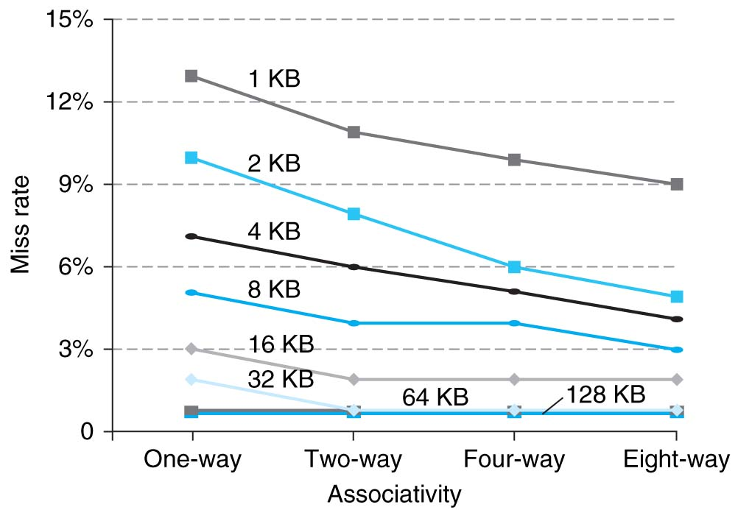
Cache Associativity

Slide 69
LRU replacement algorithms
only needed for associative caches
requires one bit for 2-way set-associative, 8 bits (per set, 2/line) for 4-way, 24 bits for 8-way…
can be emulated with log n bits (NMRU)
can be emulated with use bits for highly associative caches (like page tables)
However, for most caches (eg, associativity <= 8), LRU is calculated exactly.
Notes:
NMRU = not-most-recently-used

Slide 70
Caches in Current Processors
Not long ago, they were DM at lowest level (closest to CPU), associative further away. Today they are less associative near the processor (2-4+), and more associative farther away (4-16).
split I and D close (L1) to the processor (for throughput rather than miss rate), unified further away (L2 and beyond).
write-through and write-back both common, but never write-through all the way to memory.
64-byte cache lines common (but getting larger)
Non-blocking
processor doesn’t stall on a miss, but only on the use of a miss (if even then)
this means the cache must be able to keep track of multiple outstanding accesses, even multiple outstanding misses.
Notes:
Emphasize that splitting I/D L1 eliminates the IM/DM structural hazard

Slide 71
Intel Nehalem (i7)
Instruction Cache
-32 KB, 4-way
-64-byte line
CPU
I$
L2 cache
L3 cache
D$
Data Cache
-32 KB, 8-way
-64-byte line
-write-back, write-allocate
CPU
I$
L2 cache
D$
Unified L2 Cache
-256 KB, 8-way
-64-byte line
-write-back, write-allocate
CPU
I$
L2 cache
D$
CPU
I$
L2 cache
Shared, unified L3 Cache
-8 MB, 16-way
-64-byte line
-write-back, write-allocate
D$

Slide 72
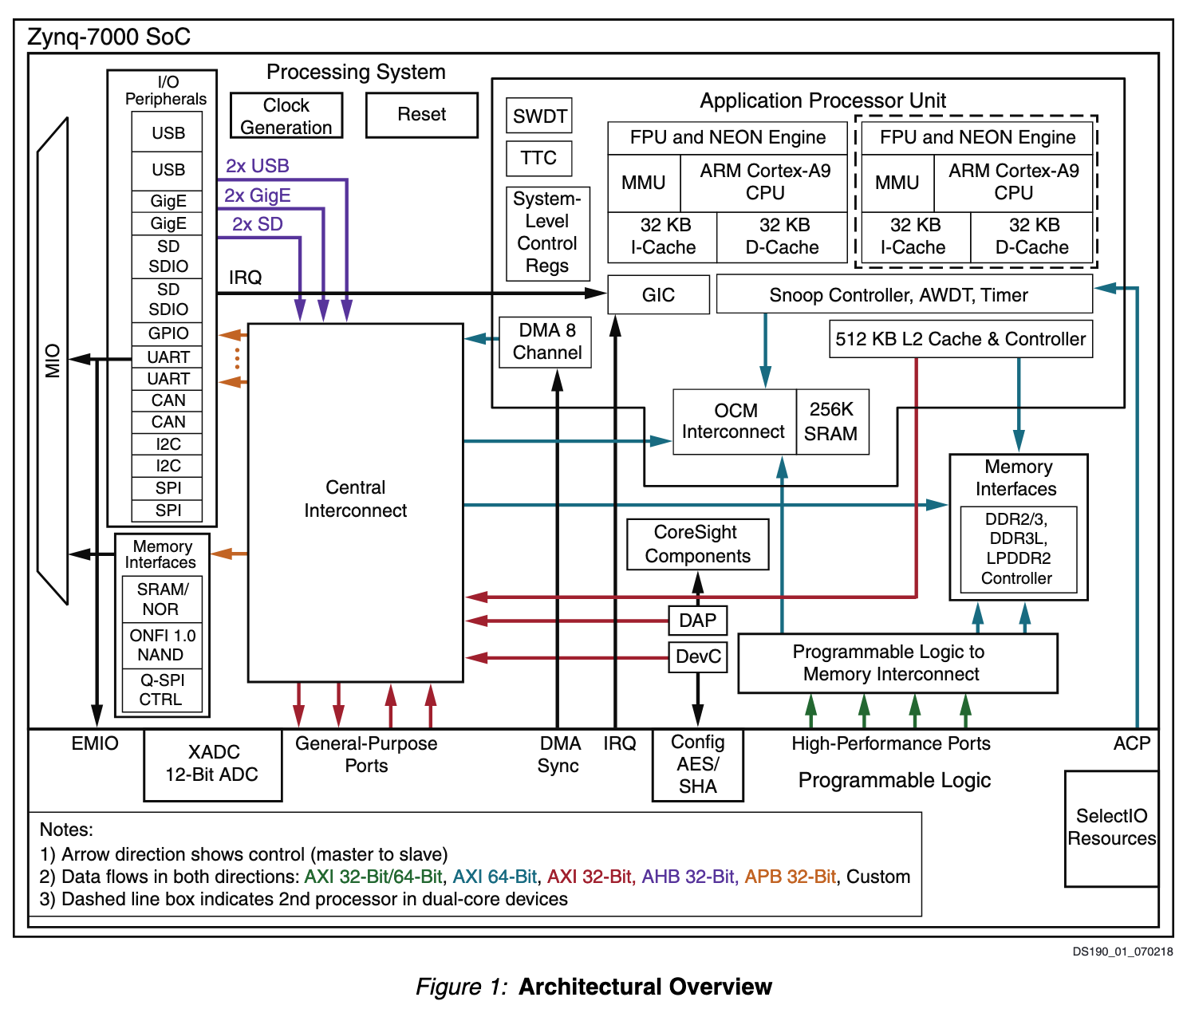
What does PYNQ Provide?

Slide 73
Key Points
Caches give illusion of a large, cheap memory with the access time of a fast, expensive memory.
Caches take advantage of memory locality, specifically temporal locality and spatial locality.
Cache design presents many options (block size, cache size, associativity, write policy) that an architect must combine to minimize miss rate and access time to maximize performance.

Slide 74
Cache Extras
Additional Examples / Alternative Drawings

Slide 75
Cache Concepts
Smaller, faster, more expensive
memory caches a subset of
the blocks
Cache
8
4
9
14
10
3
Data is copied in block-sized transfer units
4
10
Larger, slower, cheaper memory
viewed as partitioned into “blocks”
Memory
0
1
2
3
4
4
5
6
7
8
9
10
10
11
12
13
14
15
Bryant and O’Hallaron, Computer Systems: A Programmer’s Perspective; Third Edition

Slide 76
Cache Concepts
Request: 14
Data in block b is needed
Block b is in cache:
Hit!
Cache
8
9
14
3
14
Memory
0
1
2
3
4
5
6
7
8
9
10
11
12
13
14
15
Bryant and O’Hallaron, Computer Systems: A Programmer’s Perspective; Third Edition

Slide 77
Request: 12
Data in block b is needed
Block b is not in cache:
Miss!
Cache
8
9
14
3
12
Block b is fetched from
memory
12
Request: 12
Block b is stored in cache
Placement policy: determines where b goes
Replacement policy: determines which block gets evicted (victim)
Memory
0
1
2
3
4
5
6
7
8
9
10
11
12
12
13
14
15
Bryant and O’Hallaron, Computer Systems: A Programmer’s Perspective; Third Edition

Slide 78
Cache Concepts
Cold (compulsory) miss
Cold misses occur because the cache is empty.
Conflict miss
Most caches limit blocks at level k+1 to a small subset (sometimes a singleton) of the block positions at level k.
E.g. Block i at level k+1 must be placed in block (i mod 4) at level k.
Conflict misses occur when the level k cache is large enough, but multiple data objects all map to the same level k block.
E.g. Referencing blocks 0, 8, 0, 8, 0, 8, ... would miss every time.
Capacity miss
Occurs when the set of active cache blocks (working set) is larger than the cache.
Bryant and O’Hallaron, Computer Systems: A Programmer’s Perspective; Third Edition

Slide 79
Cache Concept Summary
The speed gap between CPU, memory and mass storage continues to widen.
Well-written programs exhibit a property called locality.
Memory hierarchies based on caching close the gap by exploiting locality.
Bryant and O’Hallaron, Computer Systems: A Programmer’s Perspective; Third Edition

Slide 80
Types of Cache Implementation
Direct mapped cache
Simple but lower spatial efficiency
Fast
Fully associative cache
Best spatial efficiency, complicated hardware design
Slow
N-way set associative cache
Frequently used in practice to balance trade-off between performance and complexity
The cache is divided into groups of blocks, called sets.
Each memory address maps to exactly one set in the cache, but data may be placed in any block within that set.

Slide 81
Cache Abstraction & Metrics
Address
Tag Store
(Is this address in the cache? + bookkeeping)
Data Store (Stores memory blocks)
Hit/miss
Data
Cache hit rate = #hits/#accesses
Average memory access time = #hit rate*hit latency + #miss rate* miss latency

Slide 82
Blocks and Addressing the Cache
Memory is logically divided into fixed size blocks
Each block maps to a location into the cache
Determined by the index bits in the address
Cache access
Use index bits to index to cache line
Check valid stored in the stored tag
Check tag bits against the tag stored in the tag store
If valid bit is true, and tag matches ➔ cache hit
tag
index
offset
2b
3b
3b

Slide 83
Direct Mapped Cache
Assume byte addressable memory, 256 bytes size of memory
8 byte blocks (block contains 8 bytes) → 32 blocks
Assume cache 64 bytes; → 8 blocks
Tag store
Data store
tag
index
offset
V | Tag
V
2b
3b
3b
==/=!
Hit?
Data

Slide 84
Direct Mapped Cache Example
Let us assume memory is 64 bytes (assume it byte addressable).
How many address bits do we need?
Address bits of 6 (m=6) bits
Each block contains 4 bytes. What is the number of unique locations we can address ?

Slide 85
Direct Mapped Cache Example
m = 6 & each block contains 4 bytes
What is the number of blocks ?
Number of blocks = 16
0 | 1 | 2 | 3
4 | 5 | 6 | 7
8 | 9 | 10 | 11
12 | 13 | 14 | 15
16 | 17 | 18 | 19
60 | 61 | 62 | 63

Slide 86
Direct Mapped Cache Example
m = 6 & each block contains 4 bytes
What is the number of blocks ?
Number of blocks = 16
What is the b (block offset)?
0 | 0 | 1 | 2 | 3
1 | 4 | 5 | 6 | 7
2 | 8 | 9 | 10 | 11
3 | 12 | 13 | 14 | 15
4 | 16 | 17 | 18 | 19
15 | 60 | 61 | 62 | 63

Slide 87
Direct Mapped Cache Example
m = 6 & each block contains 4 bytes
What is the number of blocks ?
Number of blocks = 16
What is the b (block offset)?
0 | 0 | 1 | 2 | 3
1 | 4 | 5 | 6 | 7
2 | 8 | 9 | 10 | 11
3 | 12 | 13 | 14 | 15
4 | 16 | 17 | 18 | 19
15 | 60 | 61 | 62 | 63
Block Size = 4 = 2² ➔ b = 2 ➔ The number of bits

Slide 88
Direct Mapped Cache Example
m = 6 & each block contains 4 bytes
What is the number of blocks ?
Number of blocks = 16
What is the b (block offset)?
What is the value of l ?
0 | 0 | 1 | 2 | 3
1 | 4 | 5 | 6 | 7
2 | 8 | 9 | 10 | 11
3 | 12 | 13 | 14 | 15
4 | 16 | 17 | 18 | 19
15 | 60 | 61 | 62 | 63
Block Address (m-b)
Block Offset (b=2)
Block Size = 4 = 2² ➔ b = 2
➔ The number of bits

Slide 89
Direct Mapped Cache Example
Let us assume m = 6 & each block contains 4 bytes
What is the number of unique locations we can address ?
What is the number of blocks ?
What is the value of b ?
What is the value of l ?
0 | 0 | 1 | 2 | 3
1 | 4 | 5 | 6 | 7
2 | 8 | 9 | 10 | 11
3 | 12 | 13 | 14 | 15
4 | 16 | 17 | 18 | 19
15 | 60 | 61 | 62 | 63
Block Address (m-b)
0 | 1 | 2 | 3 | 0
4 | 5 | 6 | 7 | 1
8 | 9 | 10 | 11 | 2
12 | 13 | 14 | 15 | 3
Block Offset (b=2)
Block Size = 4 = 2² ➔ b = 2
➔ The number of bits

Slide 90
Direct Mapped Cache Example
Let us assume m = 6 & each block contains 4 bytes
What is the number of unique locations we can address ?
What is the number of blocks ?
What is the value of b ?
What is the value of l ?
0 | 0 | 1 | 2 | 3
1 | 4 | 5 | 6 | 7
2 | 8 | 9 | 10 | 11
3 | 12 | 13 | 14 | 15
4 | 16 | 17 | 18 | 19
15 | 60 | 61 | 62 | 63
Block Address (m-b)
0 | 1 | 2 | 3 | 0
4 | 5 | 6 | 7 | 1
8 | 9 | 10 | 11 | 2
12 | 13 | 14 | 15 | 3
Block Offset (b=2)
Cache line
#lines = 4 =2² ➔ l =2
tag
Block Size = 4 = 2² ➔ b = 2
➔ The number of bits

Slide 91
Direct Mapped Cache Example
Let us assume m = 6 & each block contains 4 bytes
What is the number of unique locations we can address ?
What is the number of blocks ?
What is the value of b ?
What is the value of l ?
0 | 0 | 1 | 2 | 3
1 | 4 | 5 | 6 | 7
2 | 8 | 9 | 10 | 11
3 | 12 | 13 | 14 | 15
4 | 16 | 17 | 18 | 19
15 | 60 | 61 | 62 | 63
Block Address (m-b)
tag | 0 | 1 | 2 | 3 |  | 0
tag | 4 | 5 | 6 | 7 |  | 1
tag | 8 | 9 | 10 | 11 |  | 2
tag | 12 | 13 | 14 | 15 |  | 3
Block Offset (b=2)
Cache line
#lines = 4 =2² ➔ l =2
tag
Block Size = 4 = 2² ➔ b = 2
➔ The number of bits

Slide 92
Direct Mapped Cache Example
0 | 0 | 0 | 0 | 0
1 | 0 | 0 | 0 | 1
2 | 0 | 0 | 1 | 0
3 | 0 | 1 | 1 | 1
4 | 0 | 1 | 0 | 0
5 | 0 | 1 | 0 | 1
6 | 0 | 1 | 1 | 0
7 | 1 | 0 | 1 | 1
8 | 1 | 0 | 0 | 0
9 | 1 | 0 | 0 | 1
10 | 1 | 0 | 1 | 0
11 | 1 | 1 | 1 | 1
12 | 1 | 1 | 0 | 0
13 | 1 | 1 | 0 | 1
14 | 1 | 1 | 1 | 0
15 | 1 | 1 | 1 | 1
0 | 0 | 1 | 2 | 3
1 | 4 | 5 | 6 | 7
2 | 8 | 9 | 10 | 11
3 | 12 | 13 | 14 | 15
4 | 16 | 17 | 18 | 19
15 | 60 | 61 | 62 | 63
tag | 0 | 1 | 2 | 3 |  | 0
tag | 4 | 5 | 6 | 7 |  | 1
tag | 8 | 9 | 10 | 11 |  | 2
tag | 12 | 13 | 14 | 15 |  | 3

Slide 93
Direct Mapped Cache Example
0 | 0 | 0 | 0 | 0
1 | 0 | 0 | 0 | 1
2 | 0 | 0 | 1 | 0
3 | 0 | 1 | 1 | 1
4 | 0 | 1 | 0 | 0
5 | 0 | 1 | 0 | 1
6 | 0 | 1 | 1 | 0
7 | 1 | 0 | 1 | 1
8 | 1 | 0 | 0 | 0
9 | 1 | 0 | 0 | 1
10 | 1 | 0 | 1 | 0
11 | 1 | 1 | 1 | 1
12 | 1 | 1 | 0 | 0
13 | 1 | 1 | 0 | 1
14 | 1 | 1 | 1 | 0
15 | 1 | 1 | 1 | 1
0 | 0 | 1 | 2 | 3
1 | 4 | 5 | 6 | 7
2 | 8 | 9 | 10 | 11
3 | 12 | 13 | 14 | 15
4 | 16 | 17 | 18 | 19
15 | 60 | 61 | 62 | 63
tag | 0 | 1 | 2 | 3 |  | 0
tag | 4 | 5 | 6 | 7 |  | 1
tag | 8 | 9 | 10 | 11 |  | 2
tag | 12 | 13 | 14 | 15 |  | 3

Slide 94
Direct Mapped Cache Example
0 | 0 | 0 | 0 | 0
1 | 0 | 0 | 0 | 1
2 | 0 | 0 | 1 | 0
3 | 0 | 1 | 1 | 1
4 | 0 | 1 | 0 | 0
5 | 0 | 1 | 0 | 1
6 | 0 | 1 | 1 | 0
7 | 1 | 0 | 1 | 1
8 | 1 | 0 | 0 | 0
9 | 1 | 0 | 0 | 1
10 | 1 | 0 | 1 | 0
11 | 1 | 1 | 1 | 1
12 | 1 | 1 | 0 | 0
13 | 1 | 1 | 0 | 1
14 | 1 | 1 | 1 | 0
15 | 1 | 1 | 1 | 1
0 | 0 | 1 | 2 | 3
1 | 4 | 5 | 6 | 7
2 | 8 | 9 | 10 | 11
3 | 12 | 13 | 14 | 15
4 | 16 | 17 | 18 | 19
15 | 60 | 61 | 62 | 63
tag | 0 | 1 | 2 | 3 |  | 0
tag | 4 | 5 | 6 | 7 |  | 1
tag | 8 | 9 | 10 | 11 |  | 2
tag | 12 | 13 | 14 | 15 |  | 3

Slide 95
2-way set associative cache
MM = 64 bytes
CS = 32 bytes
BS = 4 bytes
Set size = 2 cache lines
#cache lines = CS/BS = 8
#sets = #cache lines/set size = 4
Block Address (m-b)
Block Offset (b=2)
tag
set line
2-way set associative cache
Find the set
Compare tag with the tags stored

Slide 96
Types of Cache Implementation
Direct mapped cache
Simple but low efficiency
Fully associative cache
Has high efficiency, complicated hardware design
N-way set associative cache
Frequently used in practice to balance trade-off between performance and complexity
The cache is divided into groups of blocks, called sets.
Each memory address maps to exactly one set in the cache, but data may be placed in any block within that set.

Slide 97
Resources
Some of the slides are adapted from Bryant and O’Hallaron, Computer Systems: A Programmer’s Perspective; Third Edition

Slide 98
Compiler Level Optimization

Slide 99
Compiler Level Optimizations
Many of the optimizations can be done by manually by the programmer, and many of the optimizations (e.g., loop) that we will see can be done by compiler (compiler can be smart).
If compiler can optimize the program, compiler should do the job!
Sometimes, it is needed to understand these optimizations because of limitations of compiler

Slide 100
Code Motion
Reduce frequency with which computation performed
If it will always produce same result
Especially moving code out of loop
void set_row(double *a, double *b,
long i, long n)
{
long j;
int ni = n*i;
for (j = 0; j < n; j++)
a[ni+j] = b[j];
}
void set_row(double *a, double *b,​
long i, long n)​
{​
long j;​
for (j = 0; j < n; j++)​
a[n*i+j] = b[j];​
}
Bryant and O'Hallaron, Computer Systems: A programmer's Perspective

Slide 101
Compiler Generated Code Motion
long j;​​
for (j = 0; j < n; j++)​​
a[n*i+j] = b[j];​
long j;​
int ni = n*i;​
for (j = 0; j < n; j++) ​
a[ni+j] = b[j];
set_row:​ testq %rcx, %rcx # Test n​ jle .L1 # If 0, goto done​ imulq %rcx, %rdx # ni = n*i​ leaq (%rdi,%rdx,8), %rdx # rowp = A + ni*8​ movl $0, %eax # j = 0​ .L3: # loop:​ movsd (%rsi,%rax,8), %xmm0 # t = b[j]​ movsd %xmm0, (%rdx,%rax,8) # M[A+ni*8 + j*8] = t​ addq $1, %rax # j++​ cmpq %rcx, %rax # j:n​ jne .L3 # if !=, goto loop​ .L1: # done:​ rep ; ret
Bryant and O'Hallaron, Computer Systems: A programmer's Perspective

Slide 102
Elimination (share) of Common Subexpressions
/* Sum neighbors of i,j */​
up = val[(i-1)*n + j ];​
down = val[(i+1)*n + j ];​
left = val[i*n + j-1];​
right = val[i*n + j+1];​
sum = up + down + left + right;
long inj = i*n + j;​
up = val[inj - n];​
down = val[inj + n];​
left = val[inj - 1];​
right = val[inj + 1];​
sum = up + down + left + right;
3 multiplications: i*n, (i–1)*n, (i+1)*n​
1 multiplication: i*n​
leaq 1(%rsi), %rax # i+1​
leaq -1(%rsi), %r8 # i-1​
imulq %rcx, %rsi # i*n​
imulq %rcx, %rax # (i+1)*n​
imulq %rcx, %r8 # (i-1)*n​
addq %rdx, %rsi # i*n+j​
addq %rdx, %rax # (i+1)*n+j​
addq %rdx, %r8 # (i-1)*n+j​
​
imulq %rcx, %rsi # i*n​
addq %rdx, %rsi # i*n+j​
movq %rsi, %rax # i*n+j​
subq %rcx, %rax # i*n+j-n​
leaq (%rsi,%rcx), %rcx # i*n+j+n​
Bryant and O'Hallaron, Computer Systems: A programmer's Perspective

Slide 103
Reduction in Strength
Replace costly operation with simpler one
Shift, add instead of multiply or divide
16*x --> x << 4
*→ +
int ni = 0;​
for (i = 0; i < n; i++) {​
for (j = 0; j < n; j++)​
a[ni + j] = b[j];​
ni += n;​
}
for (i = 0; i < n; i++) {​
int ni = n*i;​
for (j = 0; j < n; j++)​
a[ni + j] = b[j];​
}

Slide 104
Memory Aliasing
/* Sum rows is of n X n matrix a​
and store in vector b */​
void sum_rows1(double *a, double *b, long n) {​
long i, j;​
for (i = 0; i < n; i++) {​
b[i] = 0;​
for (j = 0; j < n; j++)​
b[i] += a[i*n + j];​
}​
}
# sum_rows1 inner loop​
.L4:​
movsd (%rsi,%rax,8), %xmm0 # FP load​
addsd (%rdi), %xmm0 # FP add​
movsd %xmm0, (%rsi,%rax,8) # FP store​
addq $8, %rdi​
cmpq %rcx, %rdi​
jne .L4
Code updates b[i] on every iteration​
Extra store
Bryant and O'Hallaron, Computer Systems: A programmer's Perspective

Slide 105
Memory Aliasing
/* Sum rows is of n X n matrix a
and store in vector b */
void sum_rows2(double *a, double *b, long n) {
long i, j;
for (i = 0; i < n; i++) {
double val = 0;
for (j = 0; j < n; j++)
val += a[i*n + j];
b[i] = val;
}
}
# sum_rows2 inner loop​
.L10:​
addsd (%rdi), %xmm0 # FP load + add​
addq $8, %rdi​
cmpq %rax, %rdi​
jne .L10
No extra store for intermediate result
Bryant and O'Hallaron, Computer Systems: A programmer's Perspective

Slide 106
Loop Interchange
Original loop:
for(j=0; j<M; j++)
for(i=0; i<N; i++)
A[i][j]=a[i][j]+b[i][j];
Interchanged loop:
for(i=0; i<N; i++)
for(j=0; j<M; j++)
c[i][j]=a[i][j]+b[i][j];
Improved locality

Slide 107
Loop Fusion
Original loops:
for(i=0; i<N; i++)
a[i] = b[i] + 10
for(i=0; i<N; i++)
c[i] = a[i]*2
Fused loops:
for(i=0; i<N; i++){
a[i] = b[i] + 10
c[i] = a[i]*2
}
Notes:
Loop fusion is merging two or more loops.

Slide 108
Loop Fusion
Original loops:
for(i=0; i<N; i++)
a[i] = b[i] + 10
for(i=0; i<N; i++)
c[i] = a[i]*2
Fused loops:
for(i=0; i<N; i++){
a[i] = b[i] + 10
c[i] = a[i]*2
}
Reducing loop overhead
Increasing the amount of work done in a loop
Improving locality by combining loops that reference the same array
Notes:
Loop fusion is merging two or more loops.

Slide 109
Loop Distribution
It is opposite of loop fusion
Original loops:
for(i=0; i<N; i++){
a[i] = b[i] + 10
c[i] = a[i]*2
}
Distributed loops:
for(i=0; i<N; i++)
a[i] = b[i] + 10
for(i=0; i<N; i++)
c[i] = a[i]*2

Slide 110
Loop Distribution
It is opposite of loop fusion
Original loops:
for(i=0; i<N; i++){
a[i] = b[i] + 10
c[i] = a[i]*2
}
Distributed loops:
for(i=0; i<N; i++)
a[i] = b[i] + 10
for(i=0; i<N; i++)
c[i] = a[i]*2
It can improve locality in multi-core processing
It can improve hardware prefetch by separating different data streams

Slide 111
Loop Invariant Computations
Calculations that do not change between loop iterations
Can be moved outside a loop
Original loop:
for(i=0; i<N; i++)
a[i] = i* (SOME_NUMBER/100)
Transformed loop:
for(i=0; i<N; i++)
a[i] = i* funct();

Slide 112
Loop Unrolling
void foo(
int A[8],
int B[8]) {
for(int i=0;i<8; i+=2){
B[i]=A[i]*3;
B[i+1]=A[i+1]*3;
}
}
void foo(
int A[8],
int B[8]) {
for(int i=0;i<8;i++){
B[i]=A[i]*3;
}
}
Increases ILP
To reduce loop overhead instructions
Increases code size

Slide 113
Dead Code Elimination
int global;
void f ()
{
int i;
i = 1; /* dead store */
global = 1; /* dead store */
global = 2;
return;
global = 3; /* unreachable */
}
int global;
void f ()
{
global = 2;
return;
}

Slide 114
Constant Folding
Evaluate constant expressions at compile time
Only possible when side-effect freeness guaranteed
Int a = 4+5;
Int a = 9;
true not;
false;
Caveat: Floating implementations could be different between machines
-ffast-math (really -funsafe-math-optimizations) lets compiler ignore this

Slide 115
Constant Propagation
Variables that have constant value, e.g. c := 3
Later uses of c can be replaced by the constant
If no change of c between!
Analysis needed, as b can be assigned more than once!
Int b = 3;
Int c = 1 + b;
Int d = b + c;
Int b = 3;
Int c = 1 + 3;
Int d = 3 + c;

Slide 116
Compiler Optimization Passes
Loop Optimizations
Loop fission
Loop fusion
Loop interchange
Loop invariant code motion
Loop unrolling
…
Data Flow Optimizations
Common subexpression elimination
Constant folding and propagation
Dead code elimination
…
Code Generation Optimization
Register Allocation
Instruction Scheduling
Instruction Selection
Reordering computations
,…

Slide 117
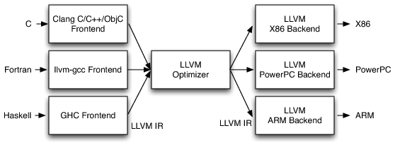
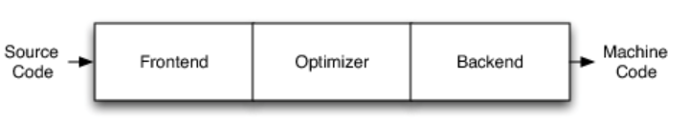
LLVM: Optimizing Compiler
LLVM is a compiler infrastructure designed as a set of reusable libraries with well defined interfaces
LLVM IR is target independent
LLVM IR
LLVM IR
Optimization
Pass 1
LLVM IR
Optimization
Pass 1
LLVM IR
LLVM IR
Optimization
Pass 1
…. . ….
https://www.aosabook.org/en/llvm.html
https://gcc.gnu.org/onlinedocs/gcc/Optimize-Options.html

Slide 118
Compiler Optimization Passes
Loop Optimizations
Loop fission
Loop fusion
Loop interchange
Loop invariant code motion
Loop unrolling
…
Data Flow Optimizations
Common subexpression elimination
Constant folding
Dead store elimination
…
Code Generation Optimization
Register Allocation
Instruction Scheduling
Instruction Selection
Reordering computations
,…

Slide 119
Optimizing Compilers
Provide efficient mapping of program to machine
register allocation
code selection and ordering (scheduling)
dead code elimination
...
eliminating minor inefficiencies
Do not optimize (usually) the "algorithm"
up to programmer to select best overall algorithm for a given task
Sorting: big-O(n²) vs. big-O(nlogn)
big-O savings are (often) more important
Have difficulty overcoming inherent limitations (cache, inherent parallelism)

Slide 120
Limitations of Optimizing Compilers
Operate under fundamental constraint
Must not cause any change in program behavior
Except, possibly when program making use of nonstandard language features
Behavior that may be obvious to the programmer can be obfuscated by languages and coding styles
e.g., Data ranges may be more limited than variable types suggest
Most analysis is performed only within procedures
Whole-program analysis is too expensive in most cases
Newer versions of GCC do interprocedural analysis within individual files
But, not between code in different files
Most analysis is based only on static information
Compiler has difficulty anticipating run-time inputs
When in doubt, the compiler must be conservative​
Bryant and O'Hallaron, Computer Systems: A programmer's Perspective

Slide 121
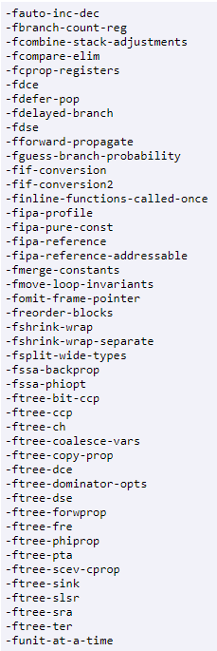
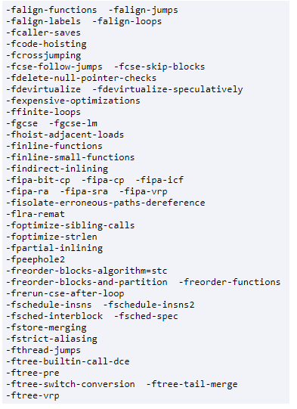
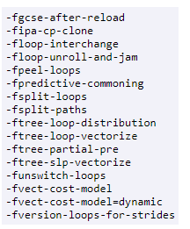
GCC O1, O2, O3 levels
-O1
-O2
-O3

Slide 122
Inline Assembly
Ability to embed low level assembly code in high-level C/C++ code
__asm [volatile] (code); /* Basic inline assembly syntax */
"ADD R0, R1, R2
Why use inline assembly ?

Slide 123
Inline Assembly
Ability to embed low level assembly code in high-level C/C++ code
__asm [volatile] (code); /* Basic inline assembly syntax */
"ADD R0, R1, R2
Why use inline assembly ?
Optimization for codes that can not be naturally expressed by high-level languages
Reversing bits
Access to professor specific instructions
NEON
System class

